Slide 1

CONTENT BASED MOVIES RECOMMENDED SYSTEM
Author: Yashshree Baviskar

Slide 2

Content
Introduction of Recommender System
Types of Recommender System
About the Content Based Recommendation
Pros and Cons
Problem Statement
About Dataset
Objective
Methodology
Data Preprocessing : Text Mining
Explanatory Data Analysis
Model Building using Cosine Similarity
References

Slide 3

INTRODUCTION
RECOMMENDER SYSTEM

Slide 4
Recommendation Systems are used to predict the "rating" or "preference" that a user would give to an item. Almost every major tech company has applied them in some form. Personalized recommendation made available by it.

Slide 5
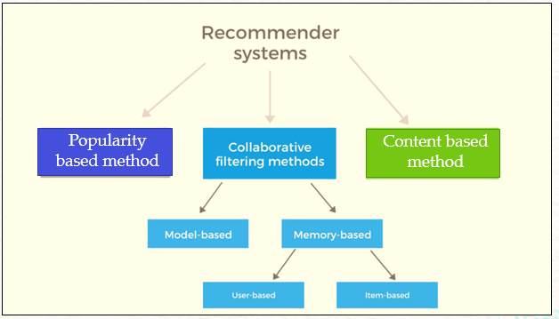
TYPES OF RECOMMENDATION SYSTEM

Slide 6
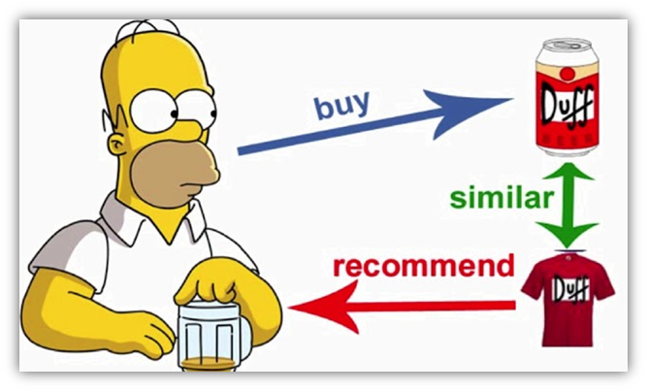
ABOUT CONTENT BASED RECOMENDATION
It suggest the simillar item based on particular item
It suggest the product based on user interest
In this system, keywords are used to describe the items, and a user profile is built to indicate the type of item this user likes
Content-based recommender systems can also include opinion-based recommender systems

Slide 7
PROS AND CONS
CONS
This model requires a fair amount of domain knowledge.
Its accuracy is largely dependent on that knowledge
It is limited in that it’s unable to expand on known user interests.
PROS
This model is easily scalable due to low amounts of data.
This does not need to compare with other users’ data.
It can offer niche results specific to the current user

Slide 8

PROBLEM STATEMENT
Using different techniques of Machine Learning, we need to build a Recommender System that recommends movies based on “ Cast, Genre, Reviews, TMDB/IMDB ratings”
In this presentation we are using Content based recommendation technique .

Slide 9
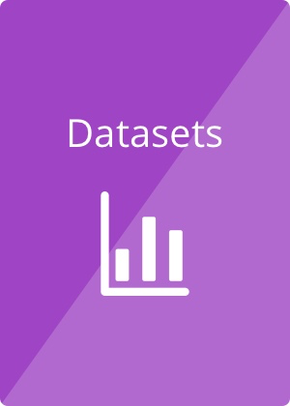
ABOUT DATASET
The dataset contained metadata for all 45000 movies listed on kaggle.
Link of dataset:
https://www.kaggle.com/rounakbanik/movie-recommender-systems/data
The dataset consists of movies released on or before July 2017.
Dataset available in the form of a stringified JSON Object.
This dataset contained features like cast, crew, plot keywords, budget, revenue, posters, release dates, languages, production companies, countries, TMDB vote counts, and vote averages.
Dataset Name | No. of feature | No. of Records
Credits | 3 | 44702
Movies_metadata | 24 | 45466
Keywords | 2 | 44702
Rating_small | 4 | 100004
Links | 3 | 45843
Links_small | 3 | 9125

Slide 10

TO BUILD THE RECOMMENDER SYSTEM MODEL BASED ON CONTENT FILTERING
OBJECTIVE

Slide 11
METHODLOGY
Research Paper breakdown and setting up the direction of project
Baseline model preparation , foundation for project
Final Testing, define MLOP’s Pipeline and application quality check
Tuning the model to be robust , basic application building
Final Presentation

Slide 12
Data Pre-Processing
Reading CSV files using pandas
Data integrity Check for missing values, duplicates values etc.
Merging of Data frame
Creation of new features and removal of redundant features.
Recommendation system vise feature selection
Text Mining & Visualization
Lemmatization and stop words removals
Data cleaning with regular expression
Text vectorization using TFIDF or Word-2-Vec embedding
Word Cloud( e.g. genres, top 50 words etc.)
Plotting Visualization related corpus length parameter
Visualization related to numerical parameter (like rating, revenue, budget)
Project Flow
Base line Recommendation System:
Base on Popularity Index recommendation system
Content based recommender system using cosine similarity
Collaborative base recommender system
Fine tuning the model implementing MLOPs
Web application development using Stream lit
Final application and Quality Check
Deployment on Heroku
Model Building and Deployment

Slide 13
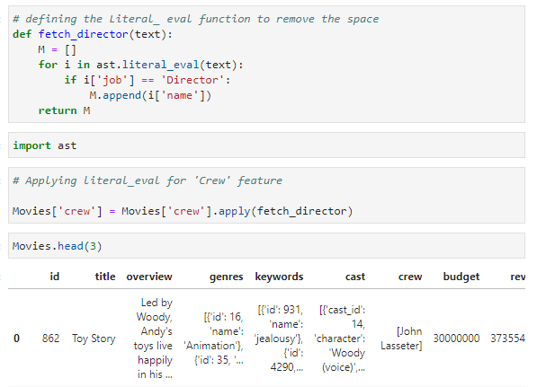
DATA PREPROCESSING: DATA MINING
Literal_eval:
Literal_eval method is one of the helper functions that helps traverse an abstract syntax tree. This function evaluates an expression node or a string consisting of a Python literal or container display.
Abstract Syntax Tree(ast):
The ast module helps Python applications to process trees of the Python abstract syntax grammar. The abstract syntax itself might change with each Python release; this module helps to find out programmatically what the current grammar looks like.
Using ast and iteral_eval function I have extracted the data from string dictionary

Slide 14
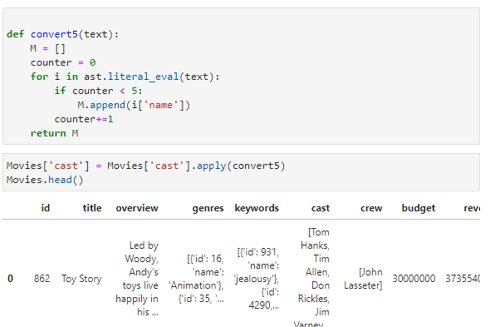
DATA PREPROCESSING: DATA MINING
Here defining function I have converted the string dictionary data-frame into a list.

Slide 15
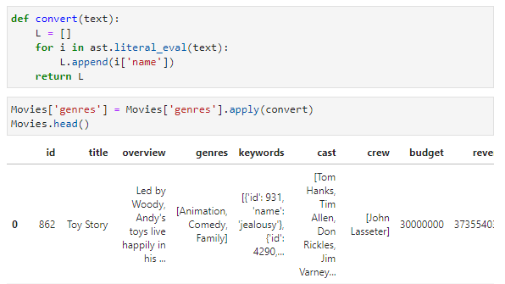
DATA PREPROCESSING: DATA MINING

Slide 16
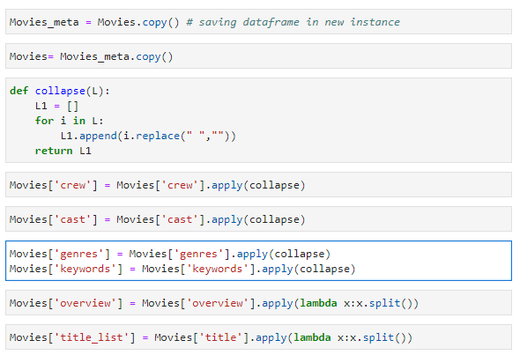
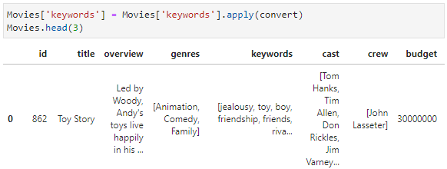
DATA PREPROCESSING: DATA MINING

Slide 17
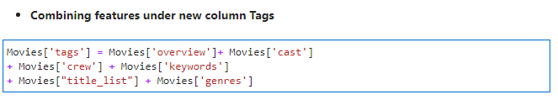

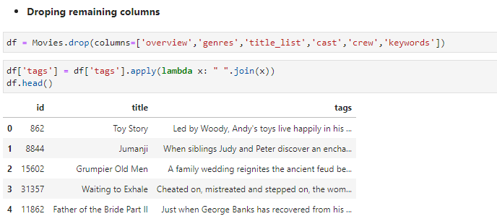
DATA PREPROCESSING: DATA MINING
Saving the clean data into csv file

Slide 18
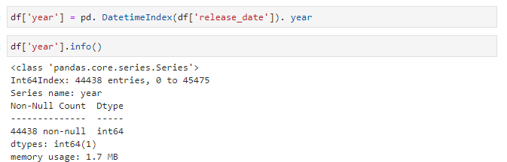
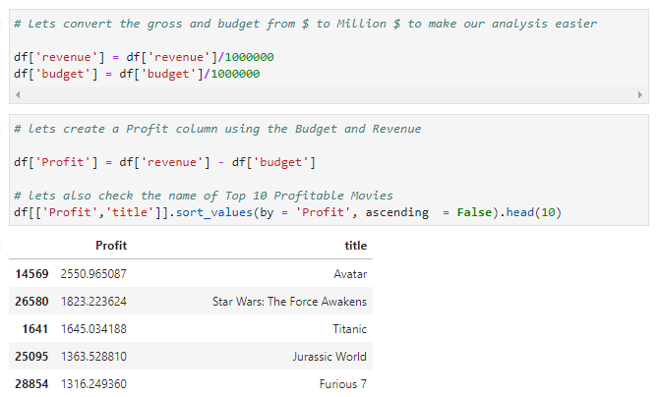
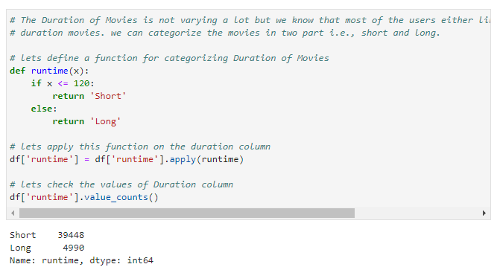
FEATURE ENGINEERING

Slide 19

EXPLANATORY DATA ANALYSIS

Slide 20
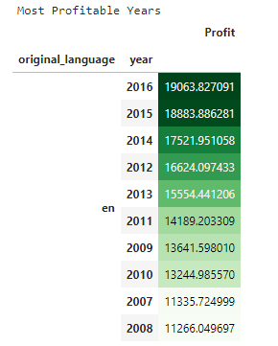
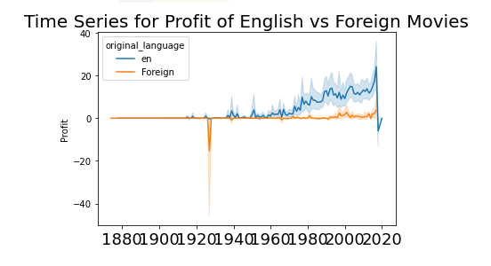
DATA VISUALIZATION
Graphs shows that year 2000-2020 profit margin is high of English movie than other language or foreign movies

Slide 21
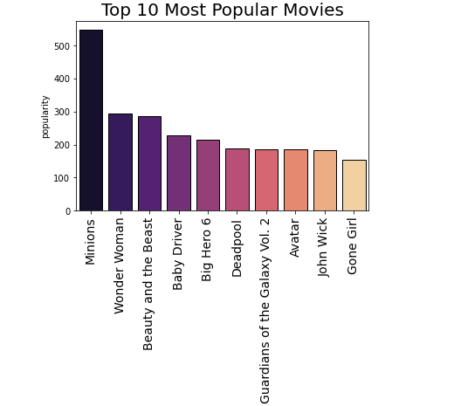
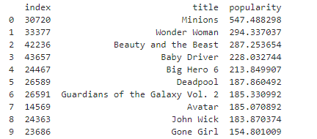
DATA VISUALIZATION
Insights
1. "Minions" is most popular movie followed by wonder woman.
2. "Gone Giri" is less popular movie.

Slide 22
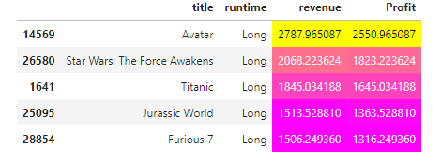
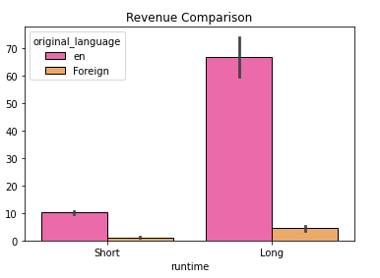
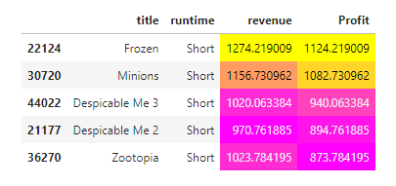
DATA VISUALIZATION
Insights:
Long duration movies have more profit than short duration movies

Slide 23

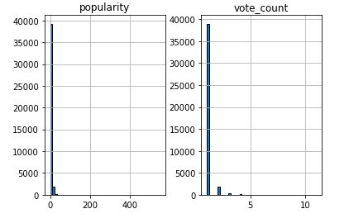
DATA VISUALIZATION
Insights :
- Here popularity count varies between 0-50 approximately
- Vote count falls from 0 – 5.

Slide 24
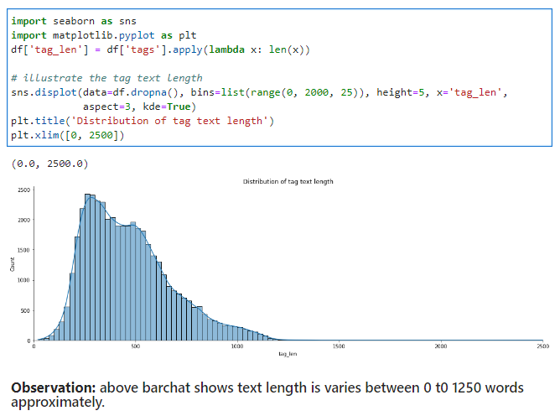
DATA VISUALIZATION

Slide 25
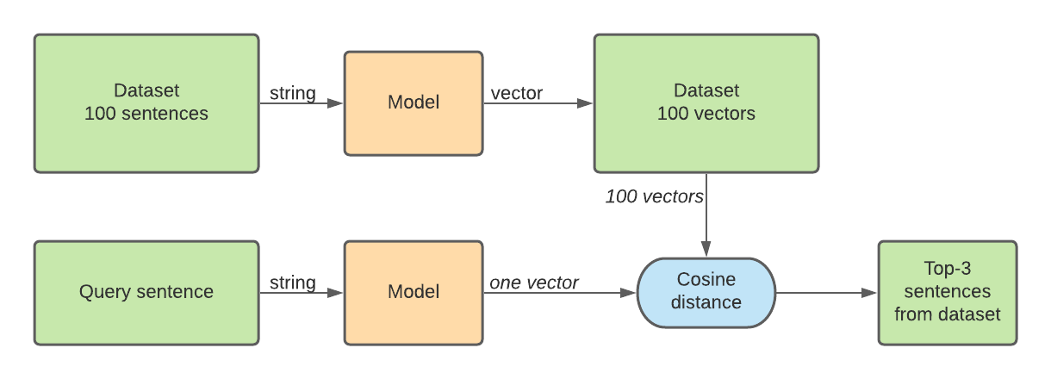
MODEL BUIDLING

Slide 26
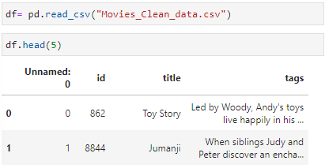
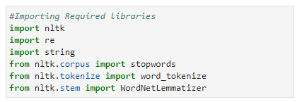
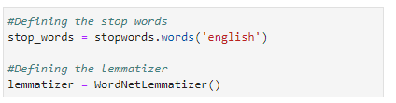
Text Mining using NLTK
Stop Words:
Stop words are the words in a stop list (or stoplist or negative dictionary) which are filtered out (i.e. Stopped) before or after processing of natural language data (text) because they are insignificant.
Lemmatization:
Lemmatization is the grouping together of different forms of the same word. In search queries, lemmatization allows end users to query any version of a base word and get relevant results.

Slide 27
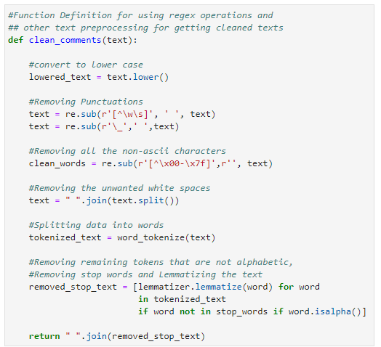
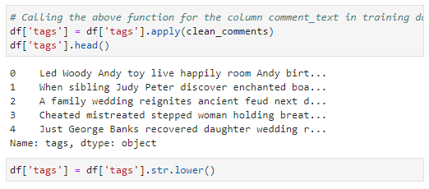

Slide 28
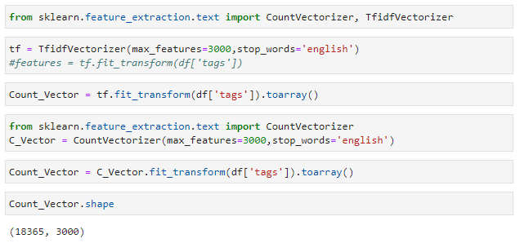
Count Vectorizer:
Count Vectorizer is a great tool provided by the scikit-learn library in Python. It is used to transform a given text into a vector on the basis of the frequency (count) of each word that occurs in the entire text. This is helpful when we have multiple such texts, and we wish to convert each word in each text into vectors.
TFIDF Vectorizer:
Term frequency — Inverse document frequency (TFIDF) is based on the Bag of Words (BoW) model, which contains insights about the less relevant and more relevant words in a document. The importance of a word in the text is of great significance in information retrieval.

Slide 29
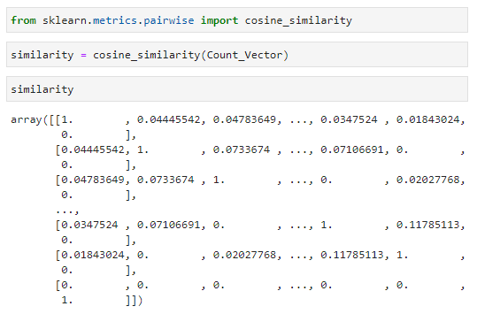
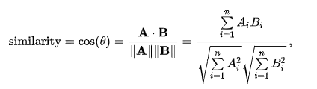
MODEL BUILDING USING COSINE SIMILARITY
Cosine Similarity:
Cosine similarity measures the similarity between two vectors of an inner product space. It is measured by the cosine of the angle between two vectors and determines whether two vectors are pointing in roughly the same direction. It is often used to measure document similarity in text analysis.
The cosine similarity is described mathematically as the division between the dot product of vectors and the product of the Euclidean norms or magnitude of each vector.

Slide 30
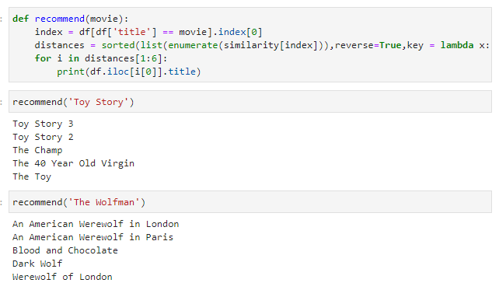
RECOMMENDATION

Slide 31
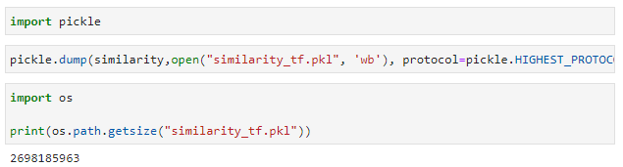
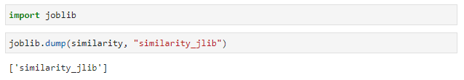
SAVING THE RECOMMENDATION

Slide 32
REFERENCES
For Recommender System
https://en.wikipedia.org/wiki/Recommender_system
https://en.wikipedia.org/wiki/Recommender_system#Content-based_filtering
For literal Eval
https://www.educative.io/answers/what-is-astliteralevalnodeorstring-in-python
https://www.aipython.in/python-literal_eval/
For AST
https://docs.python.org/3/library/ast.html#:~:text=The%20ast%20module%20helps%20Python,be%20generated%20by%20passing%20ast.
https://medium.com/@wshanshan/intro-to-python-ast-module-bbd22cd505f7

Slide 33
REFERENCES
For Stop-words
https://www.geeksforgeeks.org/removing-stop-words-nltk-python/
For Lemmatization:
https://en.wikipedia.org/wiki/Lemmatisation
For TF-IDF:
https://en.wikipedia.org/wiki/Tf%E2%80%93idf
https://towardsdatascience.com/?source=post_page-----796d339a4089-------------------------------
Cosine Similarity:
https://en.wikipedia.org/wiki/Cosine_similarity
https://www.sciencedirect.com/topics/computer-science/cosine-similarity

Slide 34


CREDITS
Special thanks to Innomatics Research Lab and my teammates without their help and motivation this task will be incomplete.

Slide 35
THANKS!
Any questions?
You can find me at
byashshree2021@gmail.com or https://in.linkedin.com/in/yashshreeb91

